Slide 1
COMP90007 Internet Technologies Workshop
Week 12 - Lab
Ruixi
huor@student.unimelb.edu.au
Notes:
Open lab material on LMS

Slide 2
Slides
https://github.com/SiaHuo/COMP90007Workshops

Slide 3
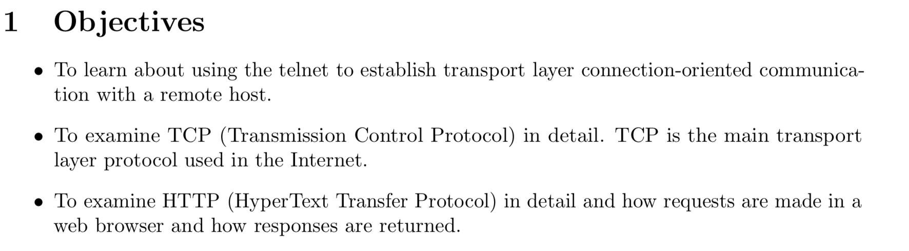

Slide 4
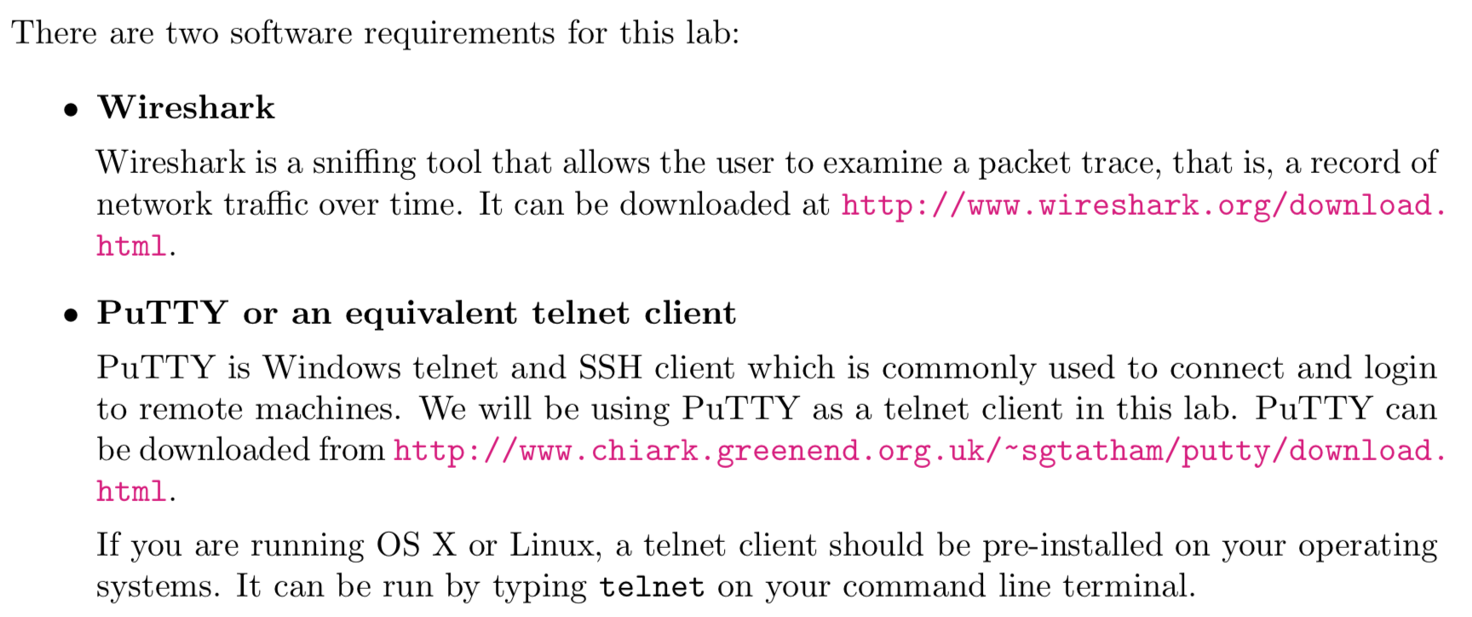
Tools
Windows user only

Slide 5
Windows user

Slide 6
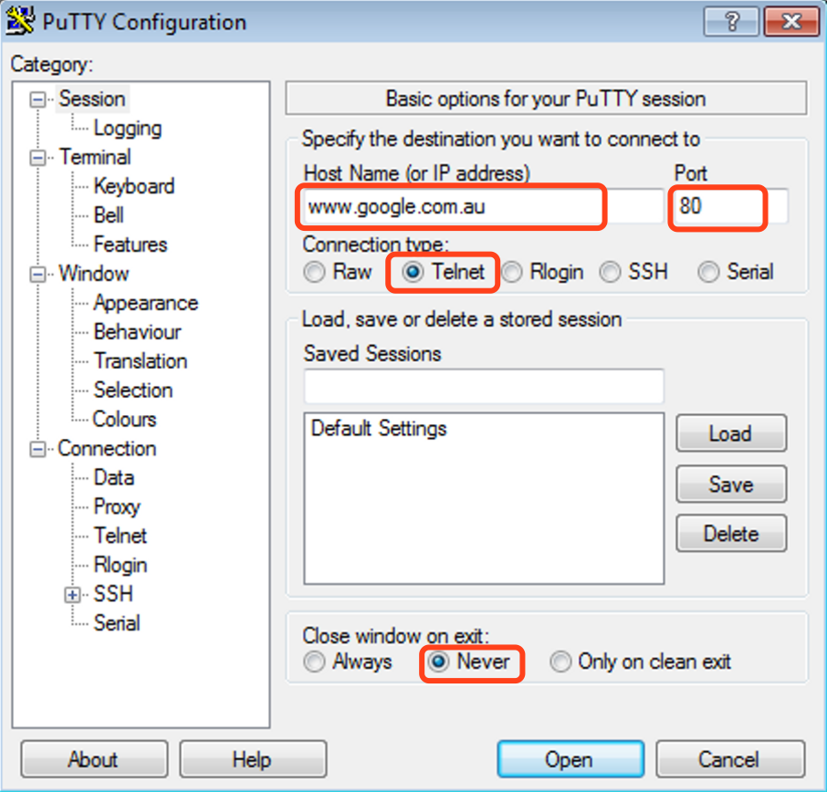
This will make sure you can read the output
after the web server closes the connection.

Slide 7
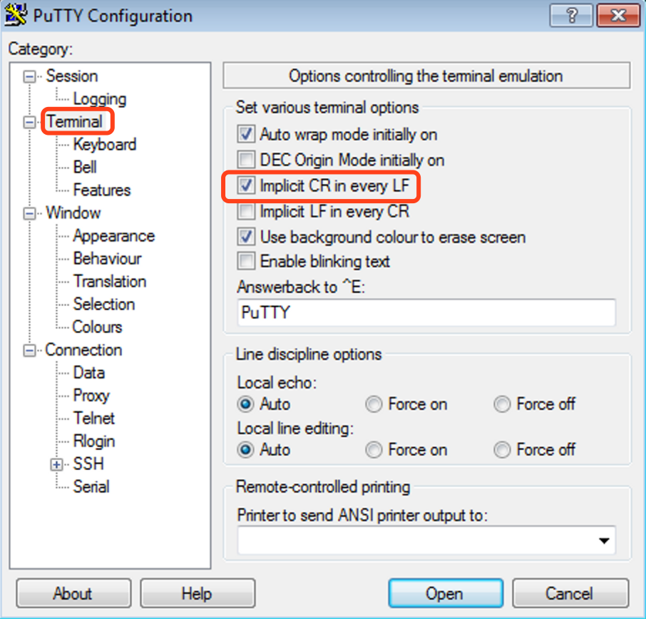
This will ensure proper line breaks are displayed, stemming from differences with Unix (\n) and Windows (\r\n) line break conventions.

Slide 8
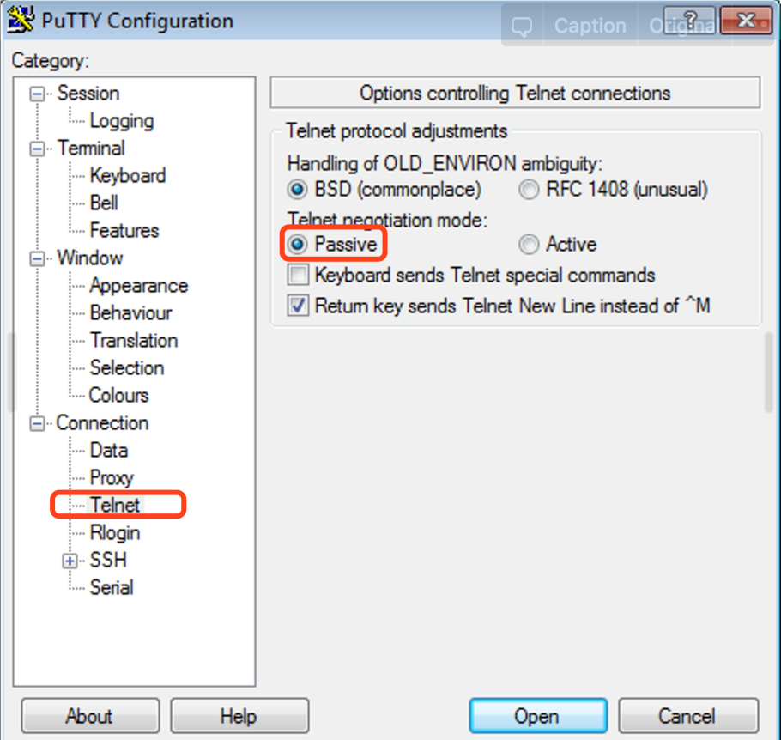
The HTTP requests don’t seem to work if you don’t set this option.
DON NOT Click OPEN NOW.
Prepare ur wireshark

Slide 9
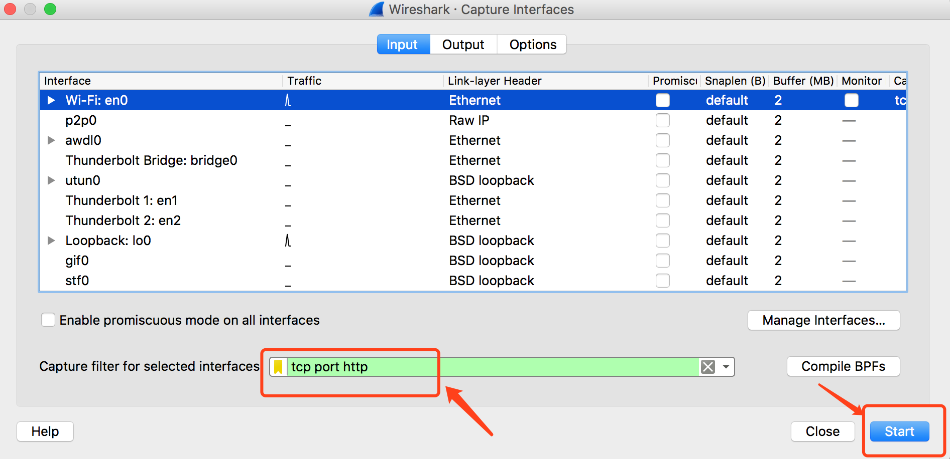

Slide 10
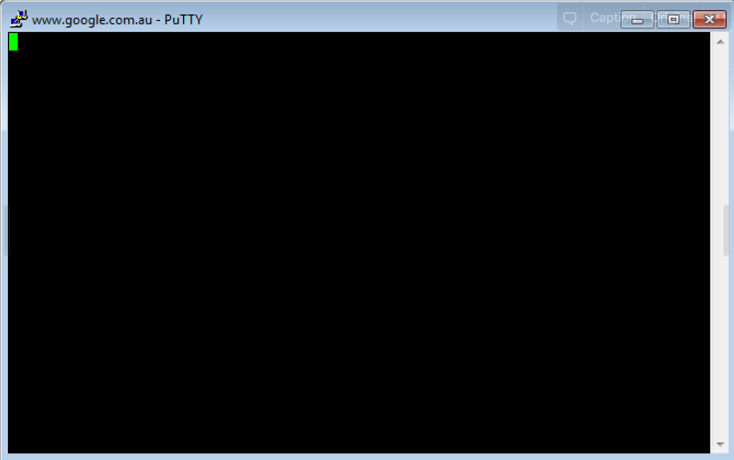
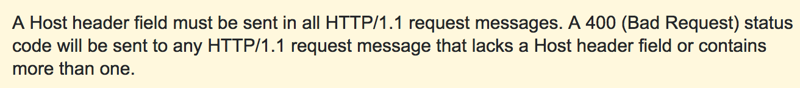
GET / HTTP/1.0
GET / HTTP/1.0
Host: www.google.com.au
Hit enter twice
GET / HTTP/1.1
Host: www.google.com.au

Slide 11
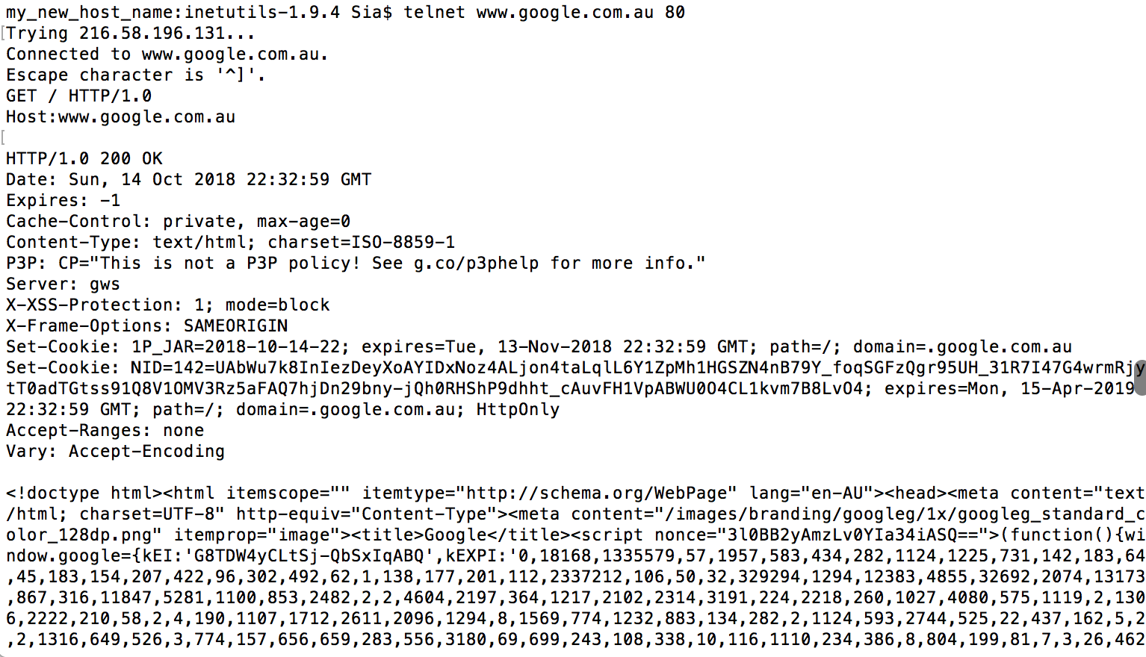
Optional for HTTP 1.0
Status: success
Header Information
HTML

Slide 12
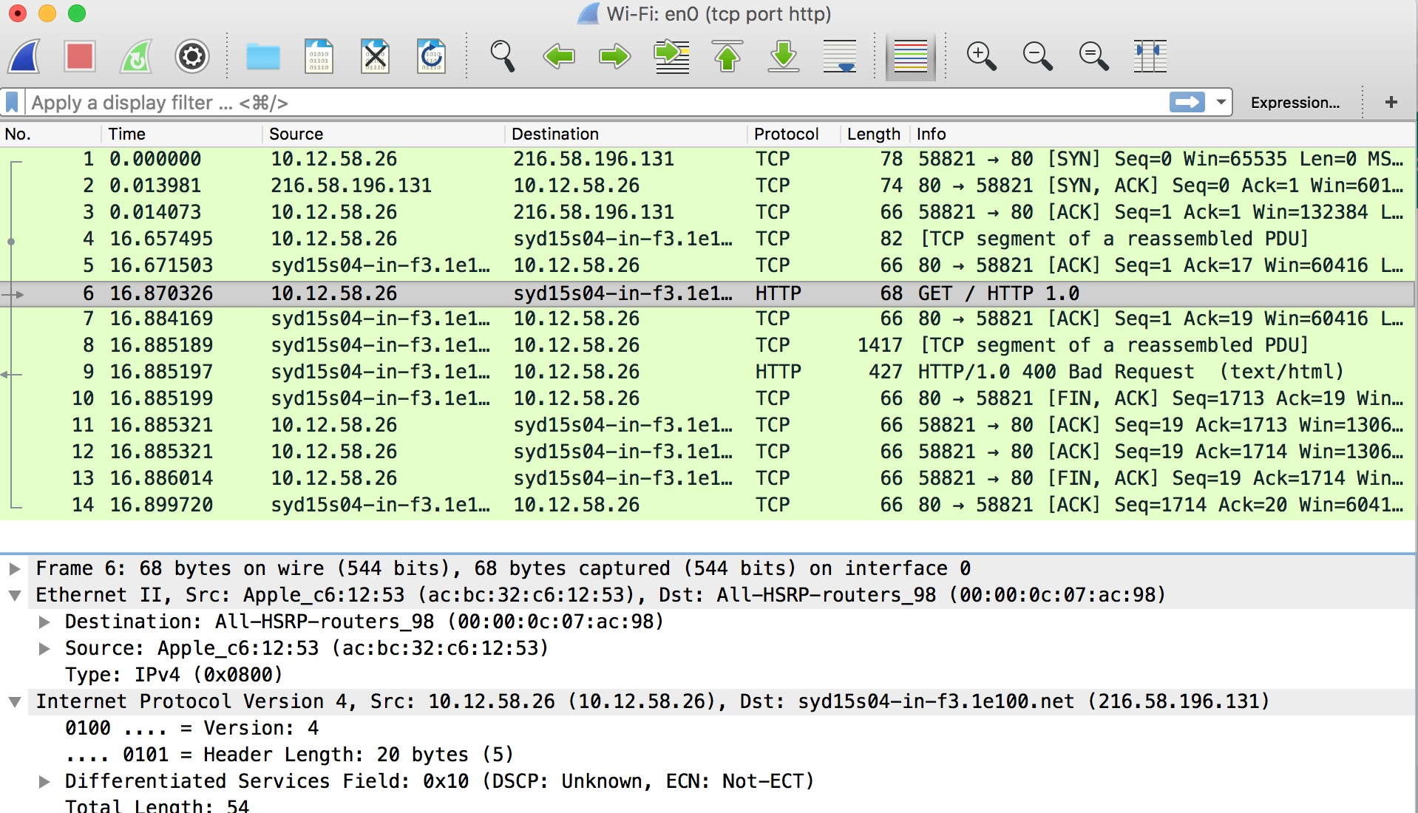

Slide 13
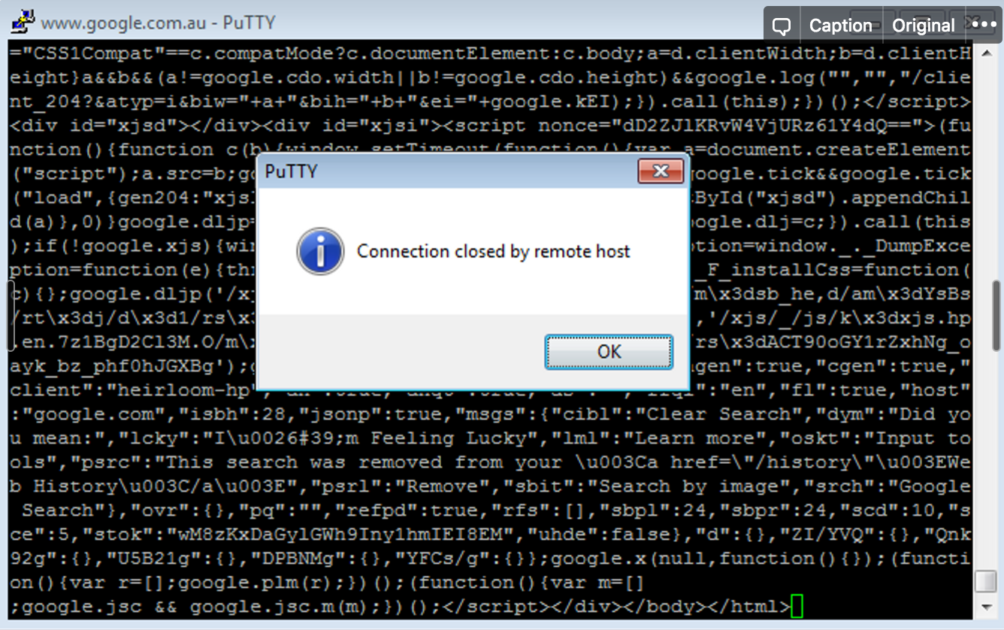
If you are using HTTP1.0 in PuTTY

Slide 14
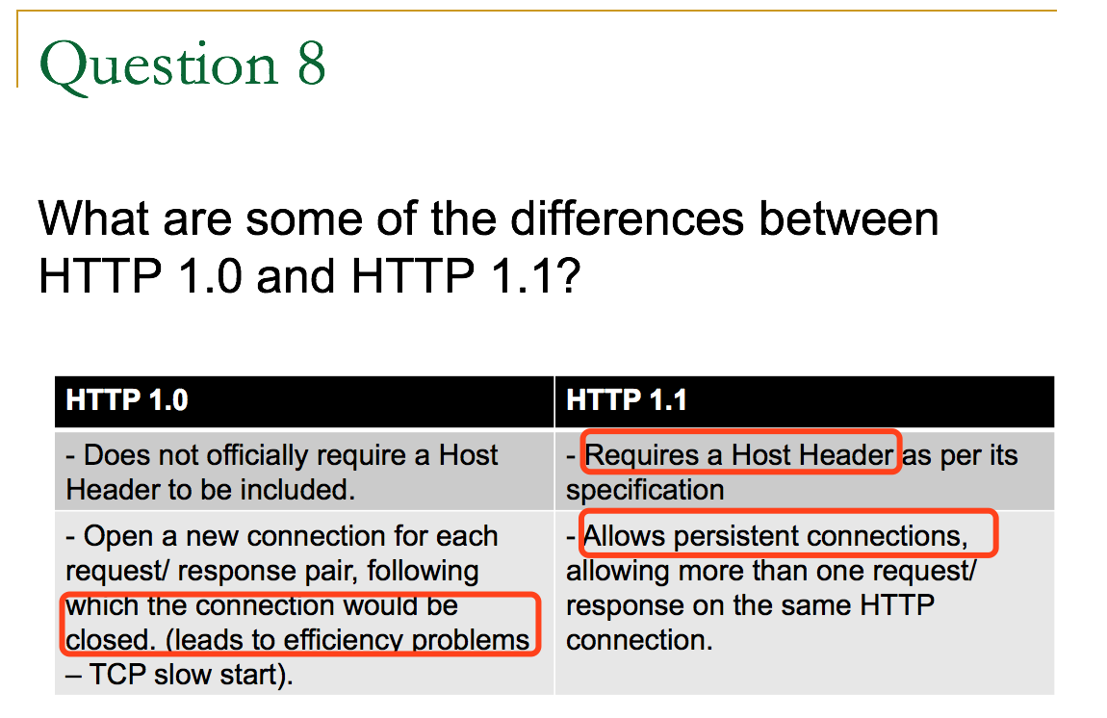
Notes:
This means that multiple web pages and web resources, such as images and other files, can be requested with one TCP connection, saving having to setup the connection and tearing it down every time a file is requested.
In HTTP/1.0, hopefully you saw that after the response was returned, the server closed the connection. In HTTP/1.1, the server waited for additional requests before closing the connection after it times out.

Slide 15
Mac user

Slide 16
Mac user only
The telnet was removed on macOS high Sierra
Step1: Install Homebrew
/usr/bin/ruby -e "$(curl -fsSL https://raw.githubusercontent.com/Homebrew/install/master/install)"
Step2: Install telnet using homebrew
brew install telnet
Another method to use telnet
nc www.google.com.au 80
Finally, Play with telnet
telnet www.google.com.au 80
GET / HTTP/1.0
GET / HTTP/1.1
HOST: www.google.com.au
Hit enter twice

Slide 17
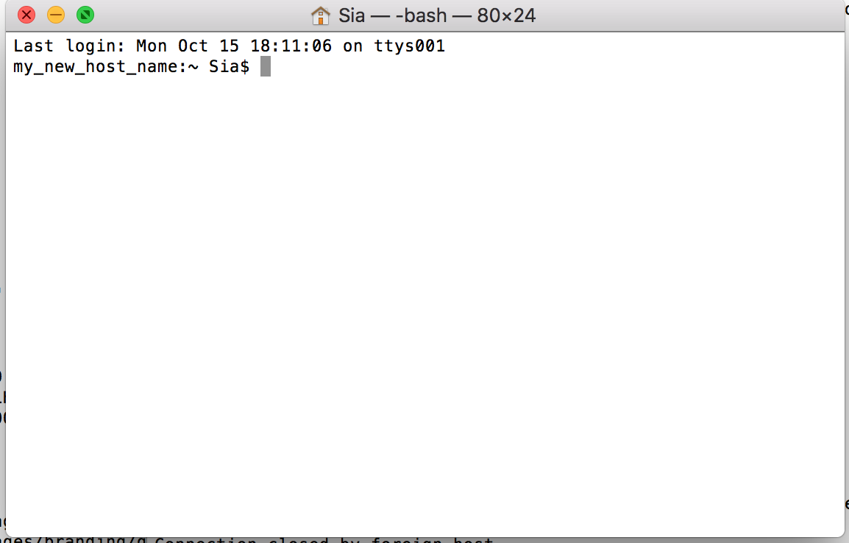
telnet www.google.com.au 80
nc www.google.com.au 80
GET / HTTP/1.0
GET / HTTP/1.0
Host: www.google.com.au
Hit enter twice
GET / HTTP/1.1
Host: www.google.com.au

Slide 18
Optional for HTTP 1.0
Status: success
Header Information
HTML

Slide 20
Question 1
What is the complete ASCII response from the web server after you sent the request ‘GET / HTTP/1.0’ ?

Slide 21
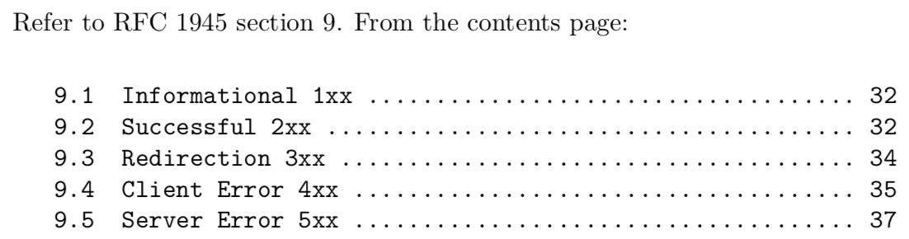
Question 2
Open up the specification on HTTP/1.0 at http://tools.ietf.org/html/rfc1945. Under section 9, what do the different categories of status codes 2xx, 3xx, 4xx and 5xx refer to?

Slide 22
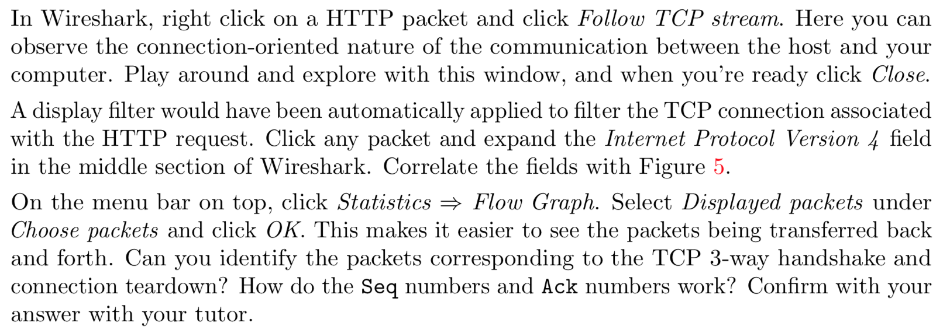
Question 3

Slide 24
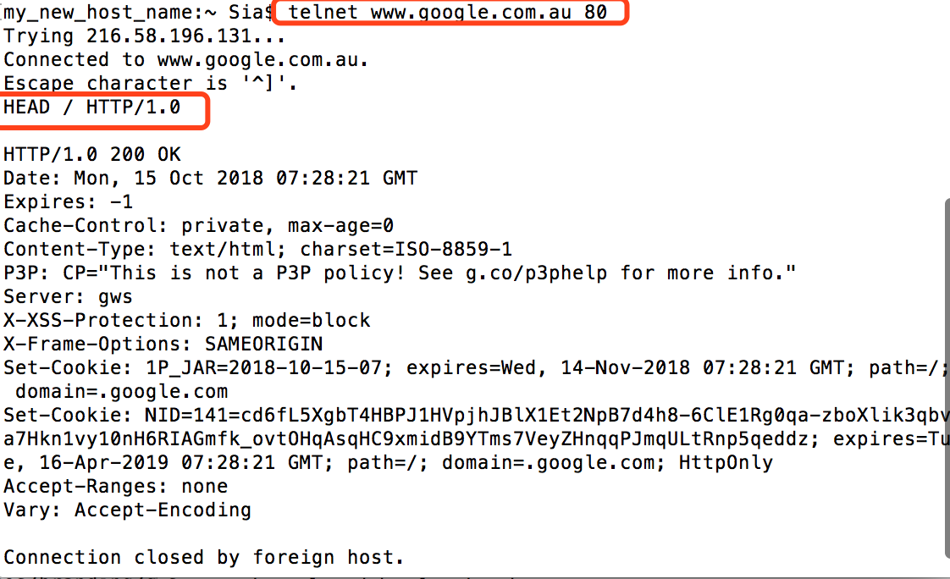
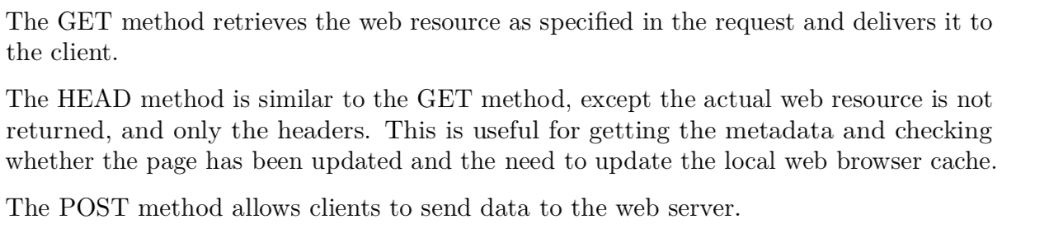
Question 4
Apart from GET, what are the other two methods in HTTP/1.0? Write a one or two sentence description for each of the three methods, with reference to RFC 1945.

Slide 25
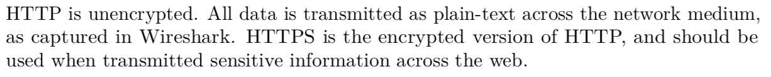
Question 7
What security implications does HTTP have, relating your answer to what you have captured over Wireshark.

Slide 26
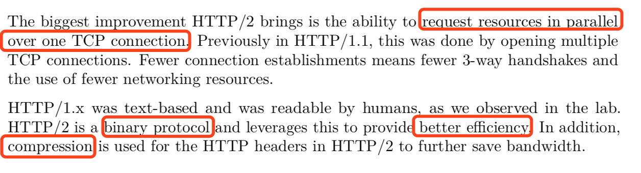
Bonus Question
What advantages does the new HTTP/2 standard bring?

